Slide 1
Brain Tumor Detection Using Convolutional Neural Networks
ICT-4442 DEEP LEARNING · FINAL PRESENTATION · TEAM 11
A leak-free comparison of an MLP, VGG16, ResNet50 and a hybrid VGG16–ResNet50
Pihu Pandey
230953134 · ResNet50
Mihika Agarwal
230911094 · VGG16
Kumari Udita
230953094 · Hybrid
School of Computer Engineering
MIT Manipal, MAHE · Oct 2026
Notes:
Presenter: Pihu. Introduce the team and who owns which model. Total talk 10–12 minutes: Pihu slides 1–3, 8 and 13; Mihika 4–7; Udita 9–12 and 14. Each member must be ready to answer viva questions on their own model.

Slide 2
Does this single MRI slice show a tumour? And is the model really looking at the tumour?
PROBLEM AND OBJECTIVES
O1 · Compare
O2 · Explain
O3 · Verify
Four architecture families under one protocol: same split, preprocessing, class weights and metrics; 3 seeds; test set scored once.
Why the models differ: missed tumours by subtype, false alarms, paired McNemar tests, Grad-CAM maps.
How much of the score comes from the tumour, not from how the dataset was assembled.
2 · Binary task: glioma + meningioma + pituitary → tumour; no tumour. Tumour = positive class.
Notes:
Presenter: Pihu. Radiologists read MRI slice by slice; a model that flags likely-tumour slices can help prioritise. We compare four models from different families. O3 was added after the interim phase showed that a rule that only checks the file size scored almost as well as our CNNs.

Slide 3
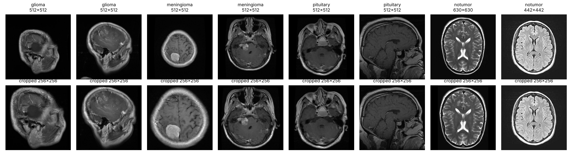
7,013 unique slices, cropped to the head before any model sees them
DATASET AND PREPROCESSING
Nickparvar Brain Tumor MRI v2: 7,200 JPEGs, 4 classes; 187 exact duplicates (MD5) removed.
5,332 tumour / 1,681 no tumour (3.2 : 1) → class weights 0.66 / 2.09.
New: brain crop — threshold, largest component, pad to square, 256 × 256. File size and borders are gone.
3 · CNN input 224 × 224 RGB with ImageNet preprocess_input; MLP input 64 × 64 grayscale in [0, 1]
Notes:
Presenter: Pihu. Tumour scans are mostly 512 by 512 (Figshare), no-tumour scans come in many sizes (Br35H). Cropping to the head and resizing to a fixed square removes the size and border cue that the interim size rule exploited.

Slide 4
Two-thirds of the official test set already had a near-copy in training
WHAT THE INTERIM SCORES HID
1,087
390
97.2%
of 1,584 official test images have a near-duplicate in train/validation
of the 400 no-tumour test images (97.5%)
interim validation accuracy of a rule that only checks “is the file 512 × 512?”
4 · Near-duplicate = pHash (8 flips/rotations) within 8 bits, confirmed by 64 × 64 pixel correlation ≥ 0.97
Notes:
Presenter: Mihika. MD5 only finds byte-identical files. Re-saved, flipped, rescaled or contrast-changed copies need a perceptual hash. 5,145 of 7,013 images have at least one near-duplicate. If a near-copy of a test image is in training, the test score measures memory, not generalisation (Yagis et al. 2021 found 29–55% inflation from slice-level leakage in brain MRI).

Slide 5
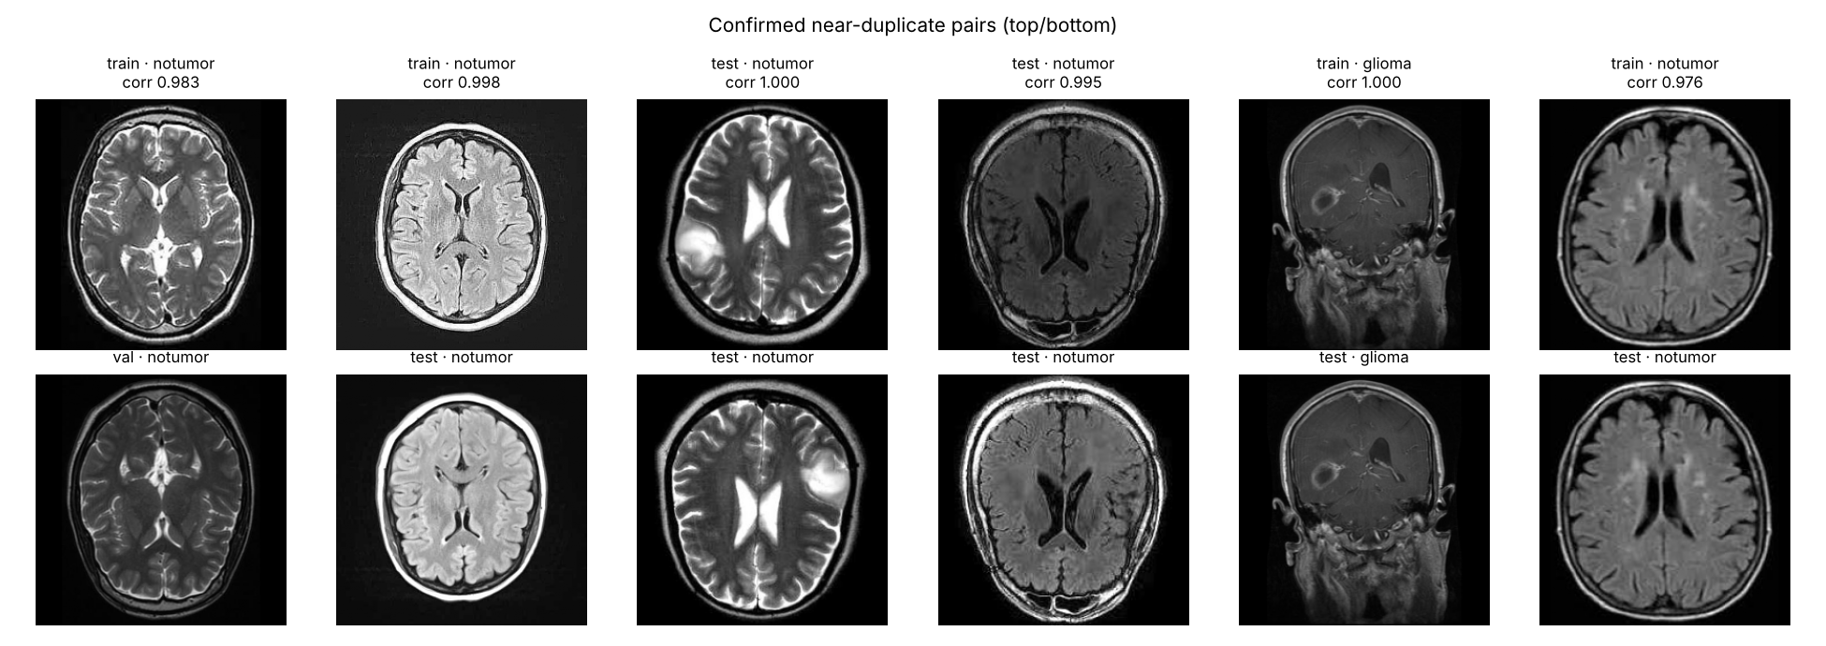
Near-duplicate groups stay on one side of the split
THE FIX: A LEAK-FREE PROTOCOL
Split | No tumour | Tumour | Total
Train | 1,034 | 3,279 | 4,313
Validation | 258 | 822 | 1,080
Test | 389 | 1,231 | 1,620
3,844 groups → StratifiedGroupKFold (13 folds: 3 test, 2 val, 8 train; seed 42). Same split, preprocessing, class weights and metrics for all four models.
5 · Metrics: accuracy, precision, recall, specificity, F1, balanced accuracy, ROC-AUC · 3 seeds · test scored once
Notes:
Presenter: Mihika. The images on the right are confirmed pairs: top and bottom are the same slice. Every group goes entirely into train, validation or test. Proportions stay close to the interim split, and the tumour share is 76% in every split. Hyper-parameters are tuned on validation only.

Slide 6
Same head, loss and training rules; only the feature extractor changes
FOUR MODELS, ONE PROTOCOL
MLP
VGG16
ResNet50
Hybrid
64×64 pixels flattened → 512 → 128 → 2. No convolution. Shared.
13 stacked 3×3 conv layers, GAP → 512. Mihika.
50 layers, residual bottlenecks, GAP → 2,048. Pihu.
Both backbones, features concatenated → 2,560. Udita.
Stage 1: ImageNet backbone frozen, head grid-searched on validation. Stage 2: last block unfrozen, Adam 1e-5, ≤ 12 epochs, early stopping; each epoch shows every image as one of 3 cached views (original + 2 augmentations). Stage kept = higher validation balanced accuracy.
6 · Adam, categorical cross-entropy, batch 32, class weights, early stopping on val loss · no GPU: frozen layers cached as float16 feature maps
Notes:
Presenter: Mihika. Every model ends in Dense(2, softmax). Because the lower layers are frozen, their output for an image never changes, so we computed it once and stored it; fine-tuning then trains exactly the unfrozen block and the head. We checked that this matches the full network to a relative difference of 6e-5.

Slide 7
Plain stacks of 3 × 3 filters: fine-tuning helped most here
MODEL 2 · VGG16 · MIHIKA AGARWAL
Architecture: 5 blocks, 13 conv layers, 14.7 M weights; GAP → Dense 256 → Dropout 0.3 → 2.
Test balanced accuracy (3 seeds)
Fine-tuned: block5_conv1–3 (7.08 M weights), ~26 min per run on CPU.
Frozen 96.2 ± 0.5%
Why: simplest deep CNN; strongest single model in several reviewed studies; 14 × 14 maps give finer Grad-CAM.
Fine-tuned 96.8 ± 0.3%
Least stable across seeds: missed tumours 25 ± 18.
7 · Notebooks 03 (interim) and 09 (final)
Notes:
Presenter: Mihika. Frozen VGG16 features were the weakest of the three CNNs (validation balanced accuracy 94.6 ± 2.3), so letting block 5 relearn MRI-specific filters helped most. It still stayed about one point behind ResNet50, and varied most between seeds: 7.2 M trainable weights in one plain block without batch normalisation.

Slide 8
Residual blocks: the strongest features, frozen or fine-tuned
MODEL 3 · RESNET50 · PIHU PANDEY
Architecture: 50 layers of 1×1–3×3–1×1 bottlenecks with identity shortcuts and batch norm, 23.6 M weights; GAP → Dense 128 → Dropout 0.5 → 2.
Test balanced accuracy (3 seeds)
Fine-tuned: conv5 stage (14.96 M weights), BatchNorm kept frozen in inference mode; ~19 min per run.
Frozen 97.0 ± 0.4%
Fine-tuned 97.9 ± 0.4%
Why: tests whether depth and more abstract features help on MRI.
Best model overall · most stable on validation (97.95 ± 0.05%).
8 · Notebooks 04 (interim) and 10 (final)
Notes:
Presenter: Pihu. Shortcuts let gradients flow through 50 layers. Its 2,048 pooled features were the most separable even frozen. Why freeze BatchNorm: with small batches on a small dataset the batch statistics are noisy; keeping the ImageNet statistics stabilises fine-tuning. Only 2 of 412 gliomas missed on seed 42.

Slide 9
Fusing both feature sets: best ranking, not the best decisions
MODEL 4 · HYBRID VGG16–RESNET50 · KUMARI UDITA
Architecture: one preprocessed image → both backbones → concatenate 512 + 2,048 = 2,560 → Dense 128 → Dropout 0.5 → 2.
Test balanced accuracy (3 seeds)
Fine-tuned: VGG16 block5 and ResNet50 conv5 together (22 M weights); ~33 min per run.
Frozen 97.6 ± 0.2%
Fine-tuned 97.7 ± 0.3%
Why: the source study’s merged model; complementary views of the same slice.
Highest ROC-AUC (0.998) · fewest false alarms among frozen models.
9 · Notebooks 05 (interim) and 11 (final)
Notes:
Presenter: Udita. Concatenation gives the head both VGG16’s finer 14×14 texture features and ResNet50’s deeper ones. It ranks scans best (highest AUC) but at the 0.5 threshold it is slightly behind ResNet50: on seed 42 ResNet50 is right on 18 scans where the hybrid is wrong, against 5 the other way (McNemar p = 0.011). Adding VGG16 brings 7 M more weights and some of its instability.

Slide 10
CNNs beat the MLP by 4–5 points; ResNet50 leads narrowly
RESULTS · COMMON TEST SPLIT (N = 1,620)
Model (final stage) | Acc. % | Recall % | Spec. % | F1 % | Bal. acc. % | AUC | FN | FP
MLP baseline | 94.1 | 95.6 | 89.2 | 96.1 | 92.4 ± 3.0 | 0.969 | 54 | 42
VGG16 (fine-tuned) | 97.4 | 97.9 | 95.7 | 98.3 | 96.8 ± 0.3 | 0.997 | 25 | 17
ResNet50 (fine-tuned) | 98.2 | 98.5 | 97.2 | 98.8 | 97.9 ± 0.4 | 0.997 | 18 | 11
Hybrid (fine-tuned) | 98.0 | 98.4 | 97.0 | 98.7 | 97.7 ± 0.3 | 0.998 | 20 | 12
Mean of 3 seeds. FN = missed tumours of 1,231; FP = false alarms of 389. All 6 pairs differ in McNemar tests (seed 42); ResNet50 vs hybrid gap is smaller than one seed standard deviation.
10 · Final stage per CNN chosen on validation: fine-tuning won for all three
Notes:
Presenter: Udita. The big gap is specificity: the MLP clears only 89% of healthy scans and depends heavily on the seed. Weight sharing and ImageNet filters explain why every CNN wins. Among CNNs, differences are about one point, so we read them with the seed spread and paired tests. Highlighted row = best balanced accuracy.

Slide 11
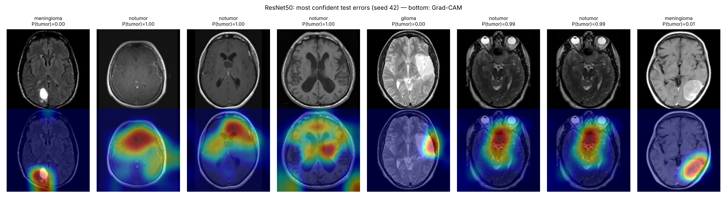
Errors follow the MRI sequence more than the lesion
ERROR ANALYSIS
Meningiomas are missed most by every model (ResNet50: 11 of 411; pituitary 1 of 408).
Misses are tumours on FLAIR/T2 slices (the no-tumour look); false alarms are healthy T1-contrast slices (the tumour look).
11 · ResNet50 fine-tuned, seed 42; bottom row = Grad-CAM (warm = pushed towards “tumour”)
Notes:
Presenter: Udita. For the missed meningiomas and the missed glioma, Grad-CAM does land on the lesion, yet P(tumour) is near zero: the network saw the abnormal region but the overall look of the slice outweighed it. Pituitary tumours are almost never missed: fixed location, sagittal/coronal T1 views that are rare among healthy scans.

Slide 12
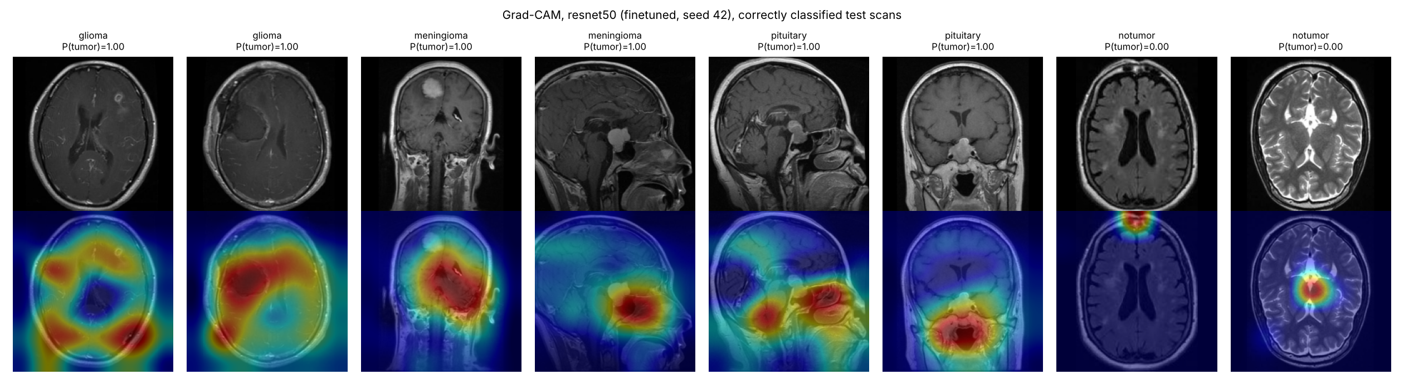
Sometimes on the lesion, often spread over the whole brain
GRAD-CAM ON CORRECT PREDICTIONS
On the sagittal meningioma and one pituitary tumour the map sits on the lesion; for both gliomas it covers most of the brain; no-tumour maps are small and weak. Gradient of P(tumour) w.r.t. conv5_block3_out (7 × 7), channel-averaged, ReLU, upsampled.
12 · Selvaraju et al., ICCV 2017 · notebooks 09–11 have the maps for every CNN
Notes:
Presenter: Udita. Grad-CAM is only partly reassuring. Where maps are diffuse, the decision may rest on global appearance rather than the lesion, which is what the next slide quantifies.

Slide 13
Leakage inflated the interim scores; the image source still leaks
HOW MUCH OF THE SCORE IS THE TUMOUR?
Frozen CNNs, test set | Specificity | Balanced acc.
P1 · original split, cropped | 99.4–99.9% | 98.0–98.7%
P2 · leak-free split, cropped | 95.0–97.0% | 96.2–97.6%
Histogram probe (no spatial info) | 73.3% | 82.2%
Cropping alone barely changed the CNNs (P0 → P1); removing near-duplicates did. A grey-level histogram still reaches 82% balanced accuracy, because healthy scans are mostly T2/FLAIR (Br35H) and tumour scans mostly T1-contrast (Figshare).
13 · Means over 3 seeds; ranges = across VGG16, ResNet50, hybrid · same confound as DeGrave et al. 2021
Notes:
Presenter: Pihu (or whoever has time). Under the original split 390 of 400 healthy test scans had a near-copy in training, so specificity looked almost perfect. Our models beat the histogram probe by 14–16 points, so they use more than contrast, but on this public dataset we cannot fully separate detecting a tumour from recognising the scanner sequence.

Slide 14
Convolution and pretraining matter most; the benchmark itself needs care
CONCLUSION AND FUTURE WORK
What we found
What we would do next
Fine-tuned ResNet50 best: 97.9% balanced accuracy, 98.5% recall, 97.2% specificity
Hybrid within 0.2 points, best AUC; VGG16 1 point behind; MLP 92.4%
Near-duplicate leakage, not file size, inflated the interim scores
Patient-level splits on data with patient IDs (BraTS, Figshare)
Same-scanner healthy and tumour scans, or intensity standardisation
An attention-based model; full fine-tuning on a GPU
Threshold tuned for 99% recall; tumour localisation
14 · Thank you · questions welcome · code: notebooks 01–12, src/, results/final/
Notes:
Presenter: Udita. Close with the two take-aways: the model ranking (MLP far behind, CNNs close, ResNet50 narrowly best) and the data lesson (leakage and source confound make near-99% claims on this dataset optimistic).

